Slide 1


Slide 2

Agenda
Business Context
Research Question
Data Overview
Analysis
Insights
Recommendations
Limitations

Slide 3




Business Context
Amazon relies heavily on digital marketing:
Amazon customers with Facebook presence
DYNAMIC – Reach and Engage
TRACKABLE – What works and what doesn’t, improvise
AFFORDABLE – Higher ROI compared to traditional marketing
15M
5M
10M
Amazon purchases through Fb
Direct Amazon purchases
Facebook gets the biggest share with an annual spend of $100M!!
Notes:
Amazon’s annual advertisement spending for Facebook is $100M.
Facebook representatives claim that Amazon should make an additional $400M per year through Facebook adds, and therefore, the annual advertisement cost of $100M (i.e. 25% of the benefits) for Amazon must be quite reasonable.
Of all Amazon customers, roughly, 15M are Facebook users and around 5M of them are visiting Amazon.com by clicking the Amazon add displayed on Facebook.
The average annual spending of an Amazon customer who directly visits Amazon.com without the Facebook interaction is $500.

Slide 4



Research Question
What is the impact of Facebook advertising on Amazon’s revenue?
Is it 4X the advertising cost?
100M
400M

Slide 5


Data Overview
Distance
Income
Facebook Visit
Age
Gender
Facebook visit
All the purchases after Facebook visit
All the purchases directly through Amazon
#Purchases
1225
2422
Sample data available
for customers from
Northern California (3677)

Slide 6
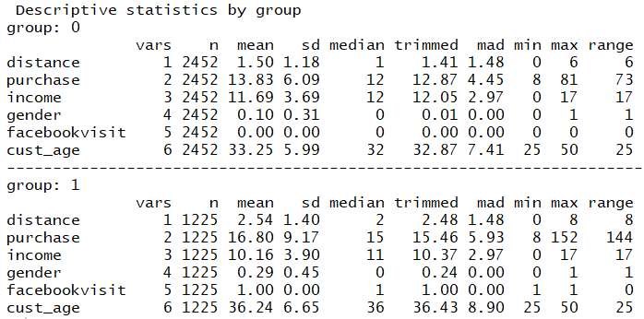
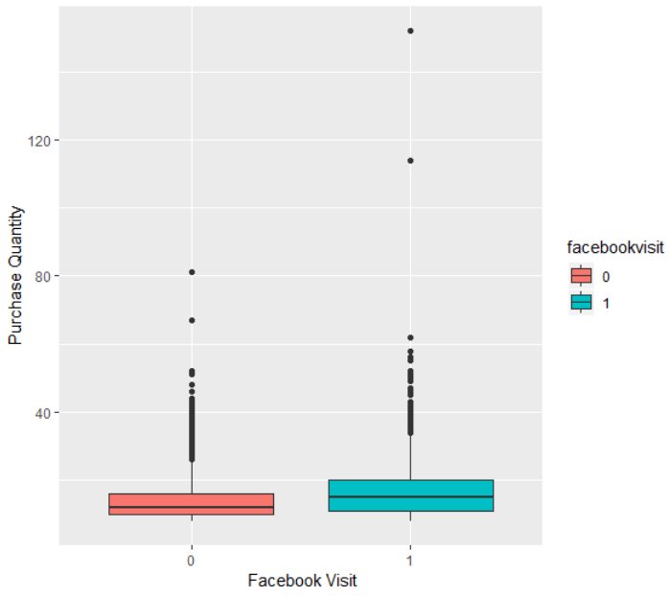
Analysis
(Purchase directly through Amazon)
(Purchase after Facebook visit)
Notes:
This is the description of data about the two groups that Bharti introduced. First, group 0, describes the customers who made the purchases directly on Amazon and group 1 describes the customers who came through the facebook advertisement. All these customers are present on Facebook.
We can see the trend that customers tend to purchase more quantities after clicking the Facebook advertisement.
The graph also confirms the same.

Slide 7
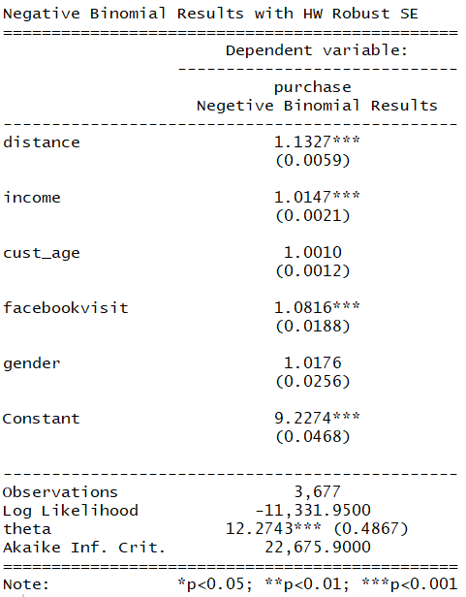
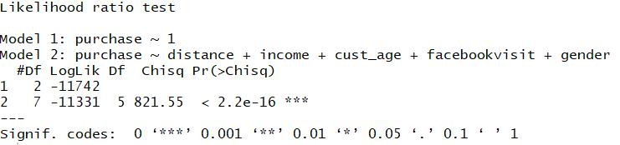
Analysis
Number of purchases is 8.16% more when the purchase is made though Facebook vs when it is made directly from Amazon.
Notes:
We chose Negative Binomial model to analyze our data.
Purchase quantity is 8.16% more when the purchase is made though Facebook vs when it is made directly from Amazon.
Now Swati will talk about the impact on the revenue.

Slide 8

Insights
$204 M
$2.5B
$2.5B
$40.8
$$× 5M customers$$
8.16%
$500
$500
8.16%
Without Facebook
With Facebook
Without Facebook
With Facebook
204M additional revenue from purchases made through Facebook

Slide 9
Recommendations
Renegotiate with Facebook to reduce Ads spending to $50M or less.
Advertising Cost of Spend (ACoS)
Total Ad Spend/ Total Ad Sales
$0.25
100/400
Collect and analyze more data to better quantify impact of Facebook Ads on revenue. E.g. user might see an Ad on Facebook and later buy directly from Amazon.

Slide 10




Limitations
Data is limited to Northern California Region.
Transaction Amount for every customer is unknown.
No data on Ad Frequency that led to a direct Amazon purchase post Facebook Ad Exposure.
Notes:
Emphasize on the limitations of our data analysis, which could have led to more accuracy in our interpretation.
We have the data which is limited only to Northern California. It might not represent the true population of Amazon’s online customer base. And customer purchase behavior may vary with geography.
Secondly, we have the purchase quantity but we do not have the transaction amount for every customer. Transaction amount per customer could have accurately predicted the impact on Amazons revenue.
Also, Many of the customers would have been exposed to the Ads multiple times but din click it directly on fb and later took decision to purchase on Amazon website. Thus, there can be instances where Ad exposure is creating product awareness or top of the mind recall leading to purchase on Amazon website.

Slide 11
Thank you!

Slide 12
Appendix

Slide 13

Final Model
Purchase = $β0+β1 facebook visit+$ $β2 income$
$$+β3gender+ β4distance+β5cust_age$$
Notes:
A

Slide 14
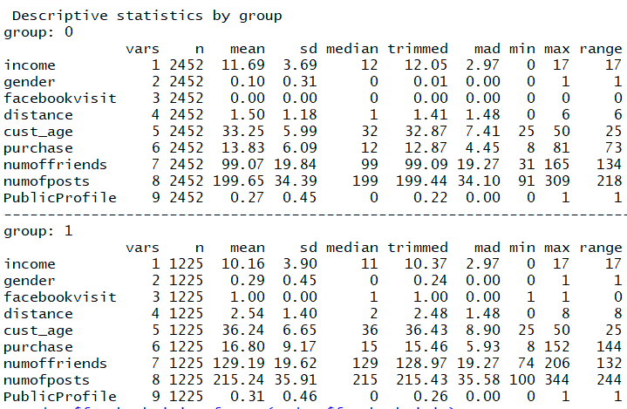
Summary Statistics – All variables

Slide 15
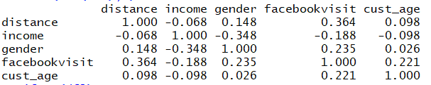
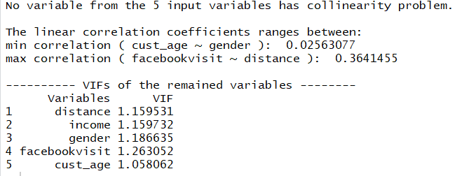
Multicollinearity - Model Variables

Slide 16
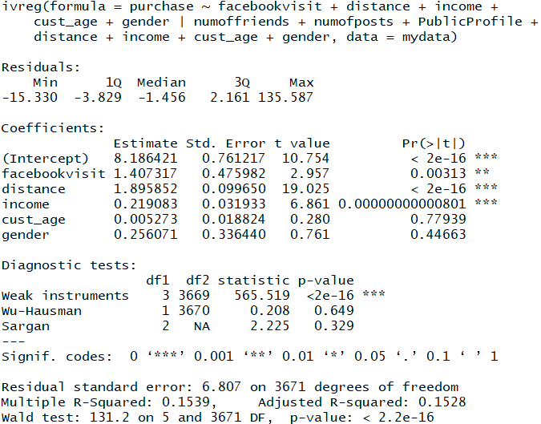
Endogeneity
Omitted Variable: Technology Friendliness
Endogenous Variable: Facebook Visit
Instrument Variables:
Number of posts
Number of friends
Public Profile

Slide 17

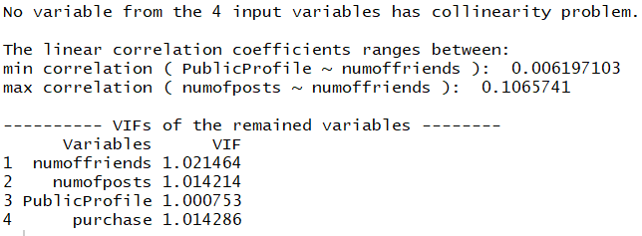
Endogeneity – IV correlation check

Slide 18
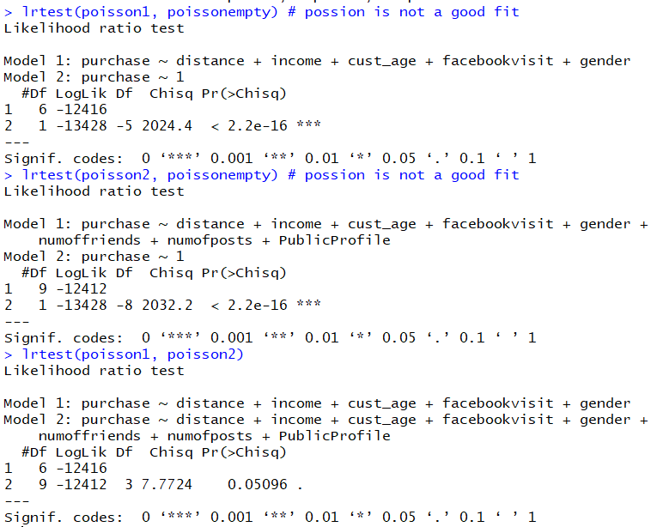
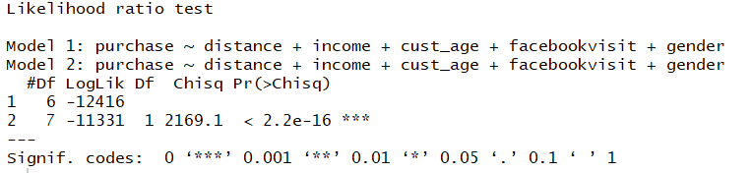
Negative Binomial vs Poisson
Comparison with negative binomial

Slide 19
Negative Binomial vs Ideal model

Slide 20
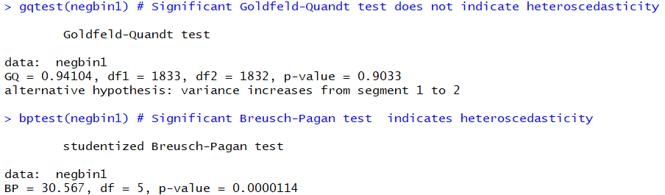
Heteroskedasticity

Slide 21
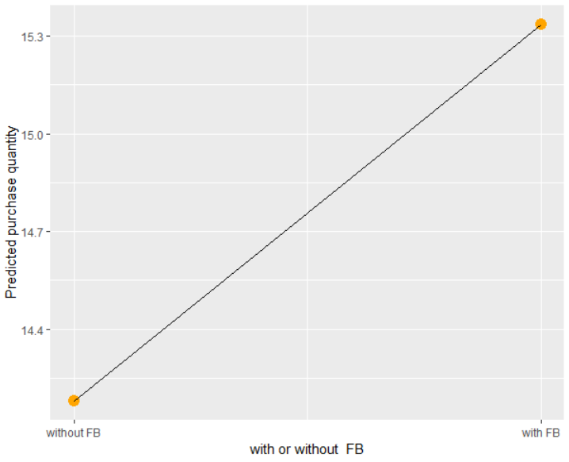

Predicted values
Notes:
A

Slide 22
Extras

Slide 23
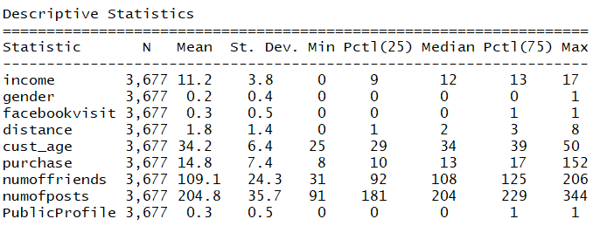
Descriptive Statistics - combined
Notes:
A

Slide 24
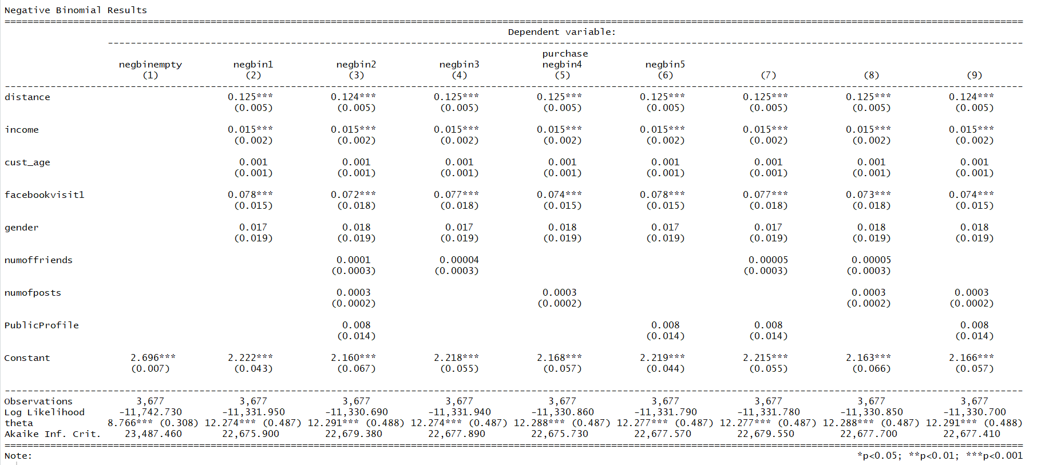
Negative Binomial – all results

Slide 25
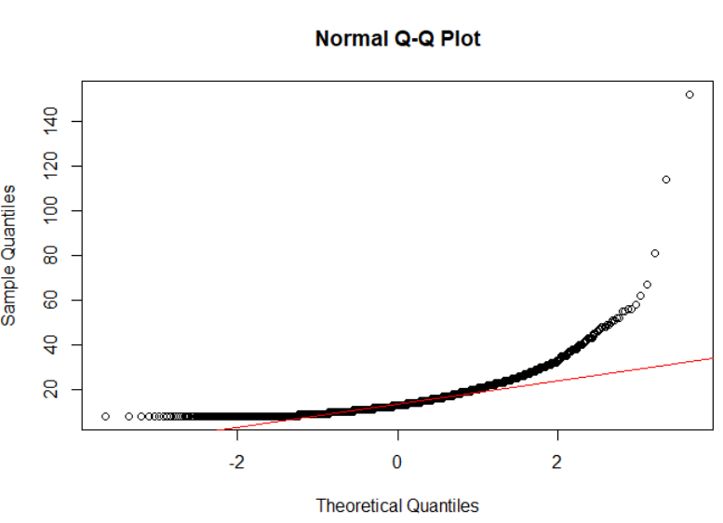
Normalization

Slide 26
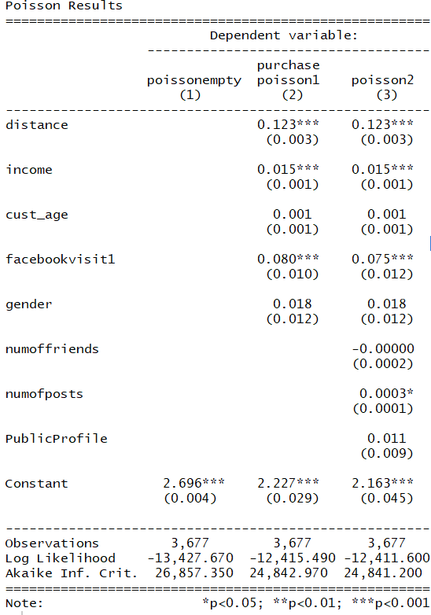
Poisson- all results

Slide 27
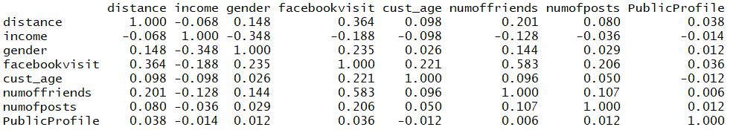
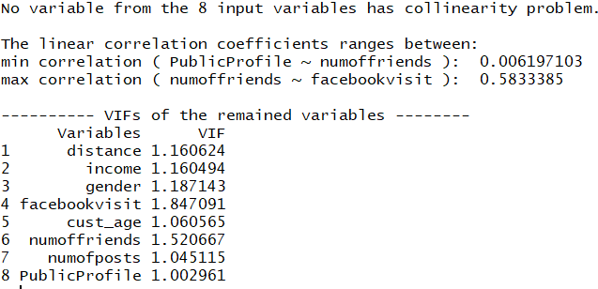
Multicollinearity – all variables

Slide 28
Outlier Detection
Outliers present in purchase quantity: 152 and 114
Both purchases were made after facebook visit

Slide 29
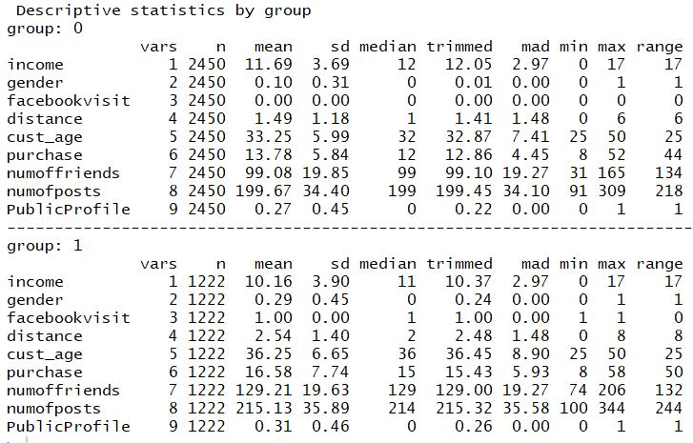
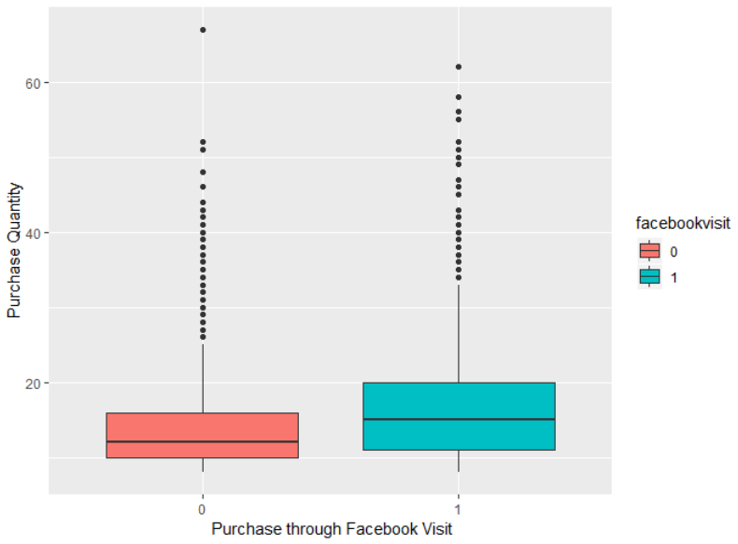
Outlier Detection- Descriptive Statistics

Slide 30
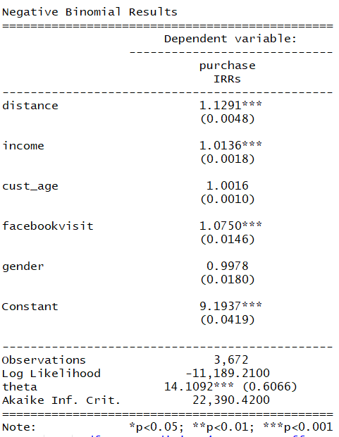
Outlier Detection- Model
Purchase quantity is 7.5% more when the purchase is made though Facebook vs when it is made directly from Amazon.

